Slide 1
Prototype of GuardarComida: An Online Food Waste Management System for Hospitality Services
Presenting By: Team Enclouders
Bauyon, John Lambert A.
Erilla, Jomira Joy G.
Visto, Dave B.

Slide 2
STAFF INTERFACE

Slide 3
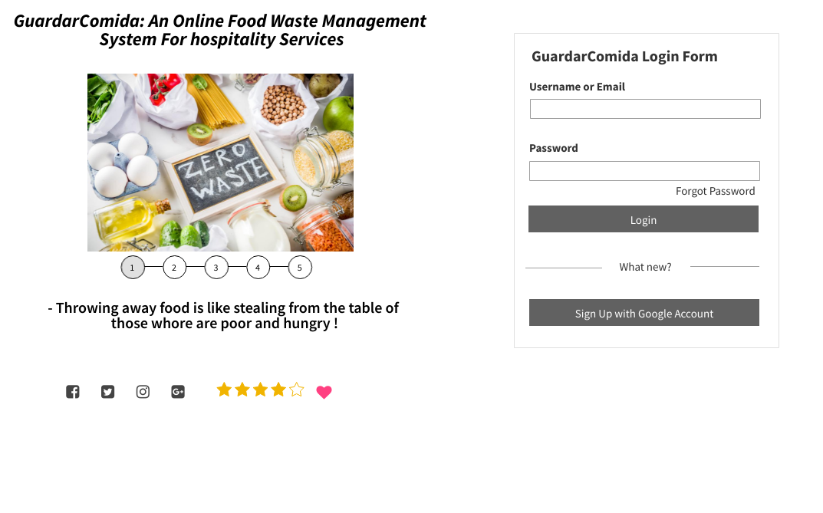
CLICK LOGIN

Slide 4
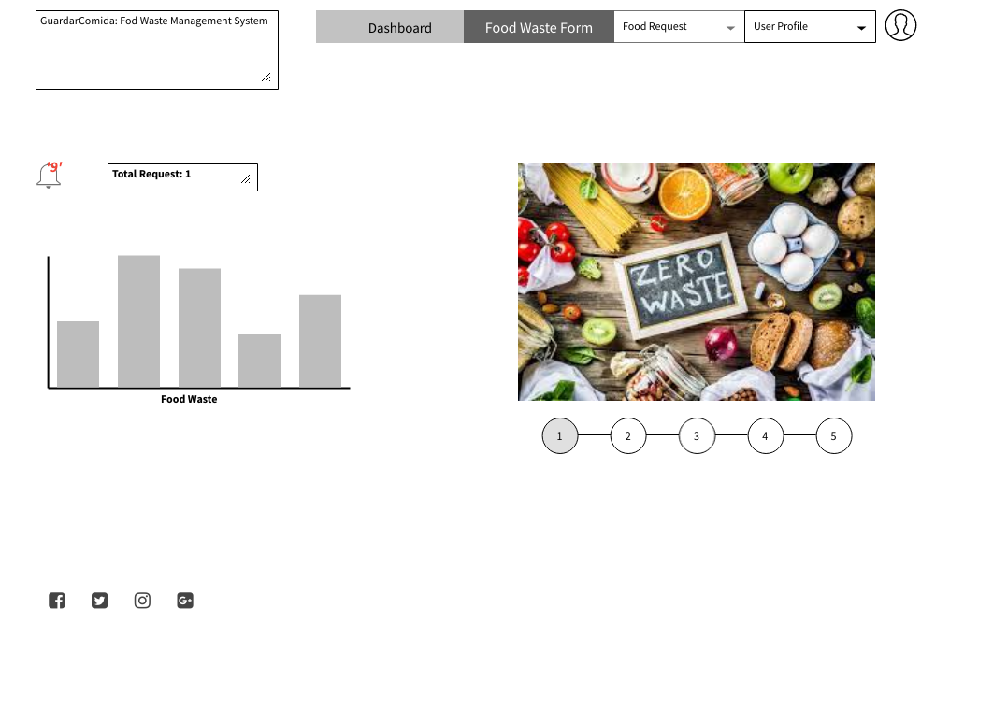
CLICK FOOD REQUEST

Slide 5
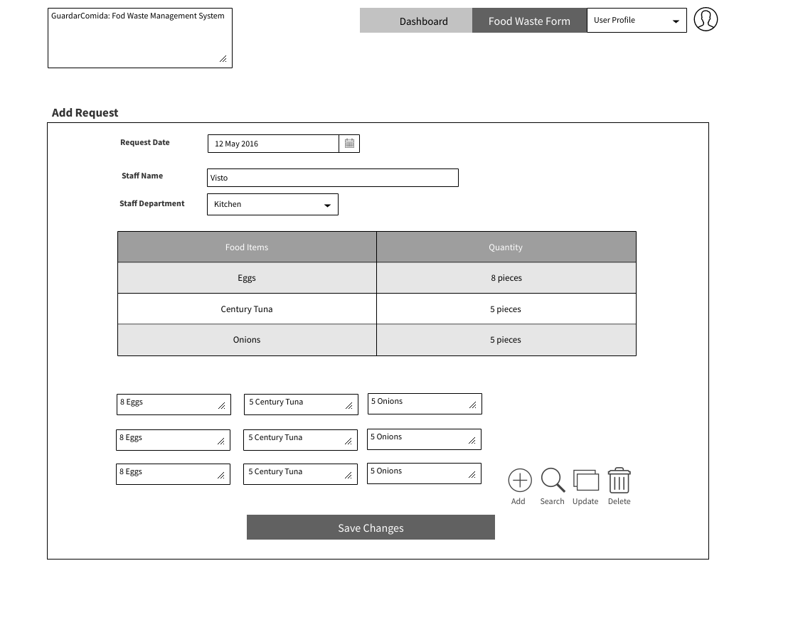
CLICK SAVE CHANGES

Slide 6
CLICK FOOD WASTE FORM

Slide 7
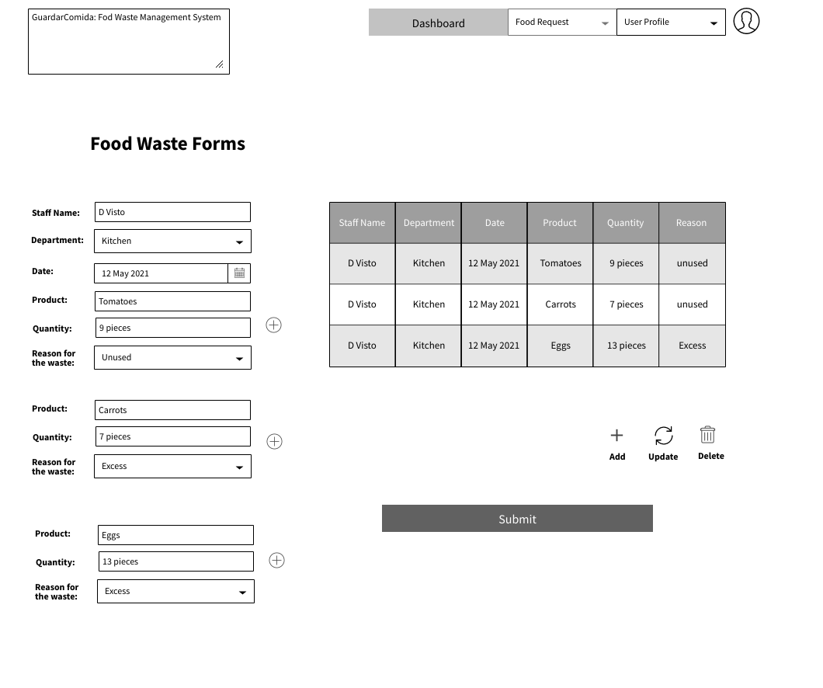
CLICK SUBMIT

Slide 8
CLICK NOTIFICATION BELL

Slide 9
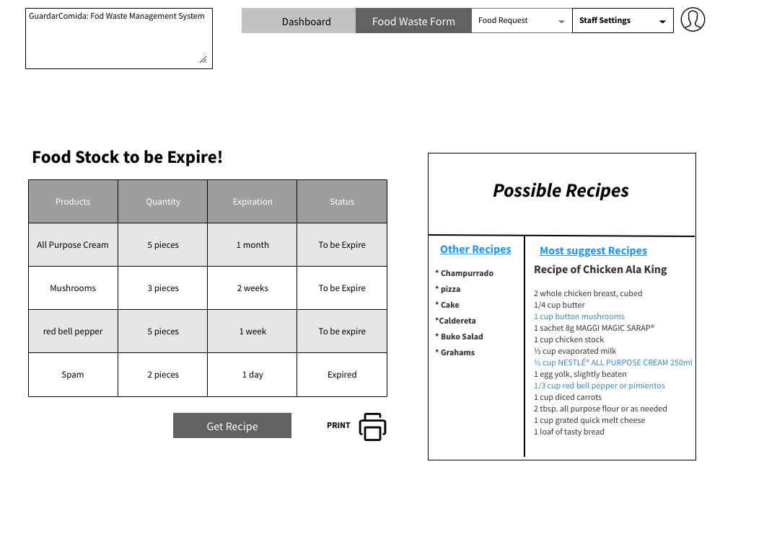
CLICK GET RECIPE

Slide 10
CLICK USER PROFILE

Slide 11
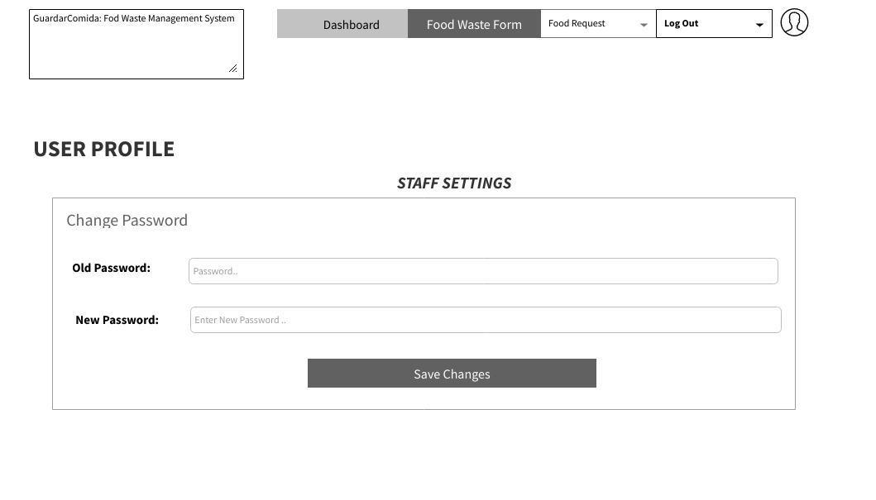
CLICK SAVE CHANGES

Slide 12
CLICK LOGOUT

Slide 14
ADMIN INTERFACE

Slide 16
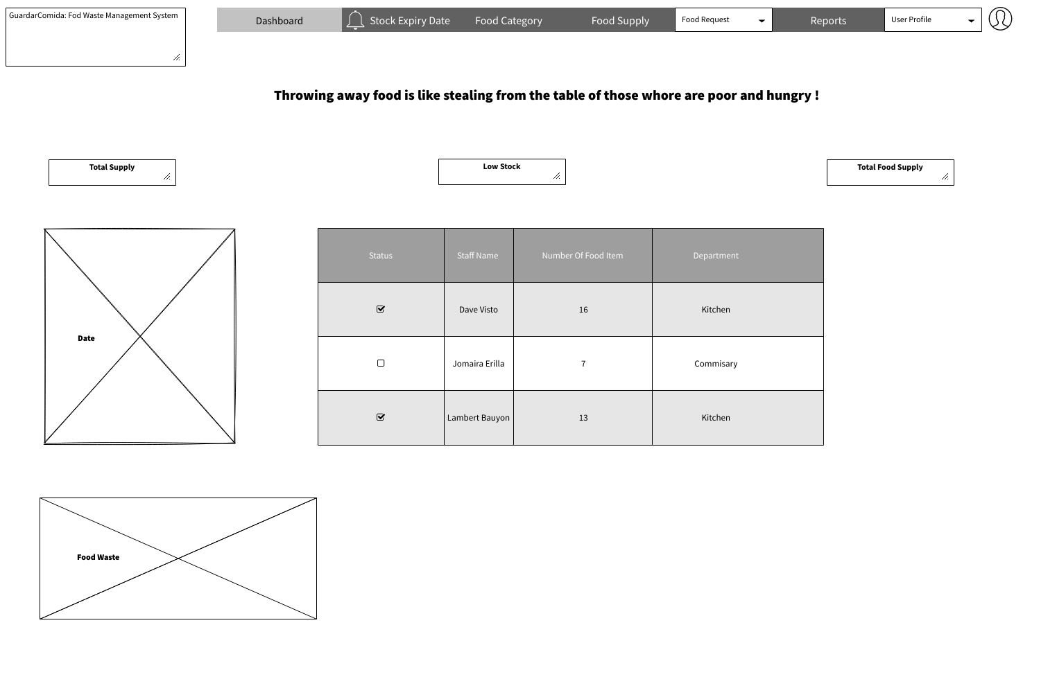

Slide 17
CHECK STATUS FOOD REQUEST

Slide 18
CLICK STOCK EXPIRY DATE

Slide 19
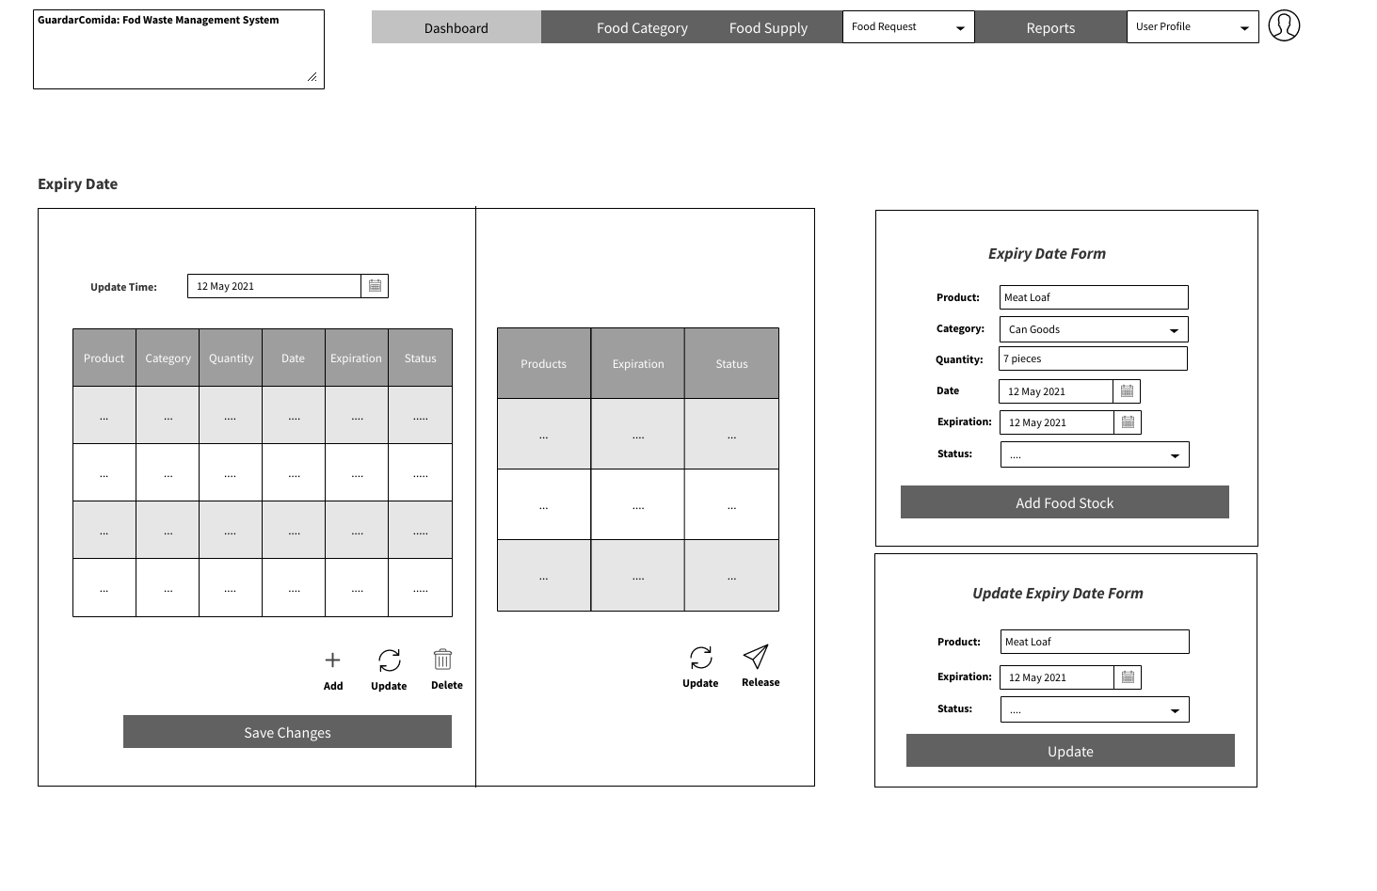
CLICK ADD FOOD STOCK

Slide 20
CLICK UPDATE

Slide 21
CLICK SAVE CHANGES

Slide 22
CLICK FOOD CATEGORY

Slide 23
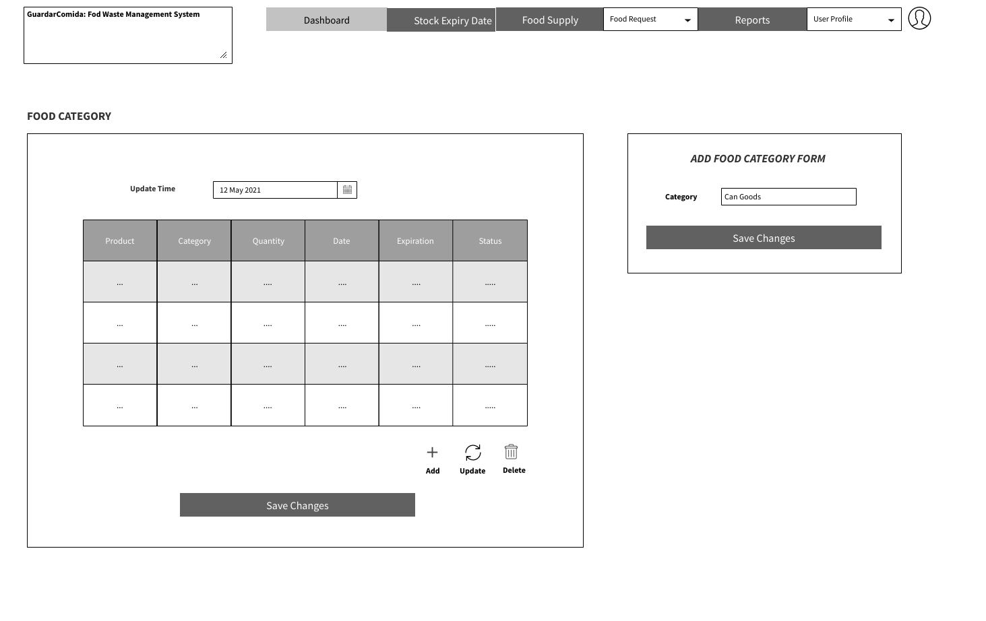
CLICK SAVE CHANGES

Slide 24
CLICK FOOD SUPPLY

Slide 25
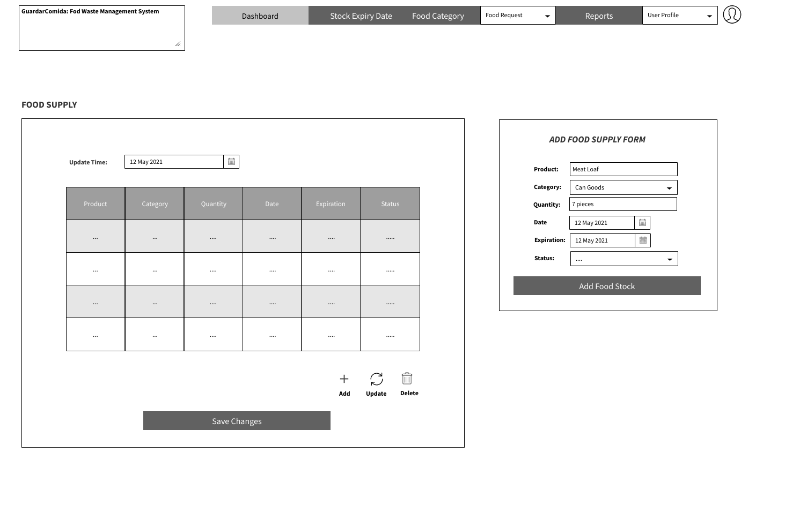
CLICK ADD FOOD STOCK

Slide 26
CLICK REPORTS

Slide 27
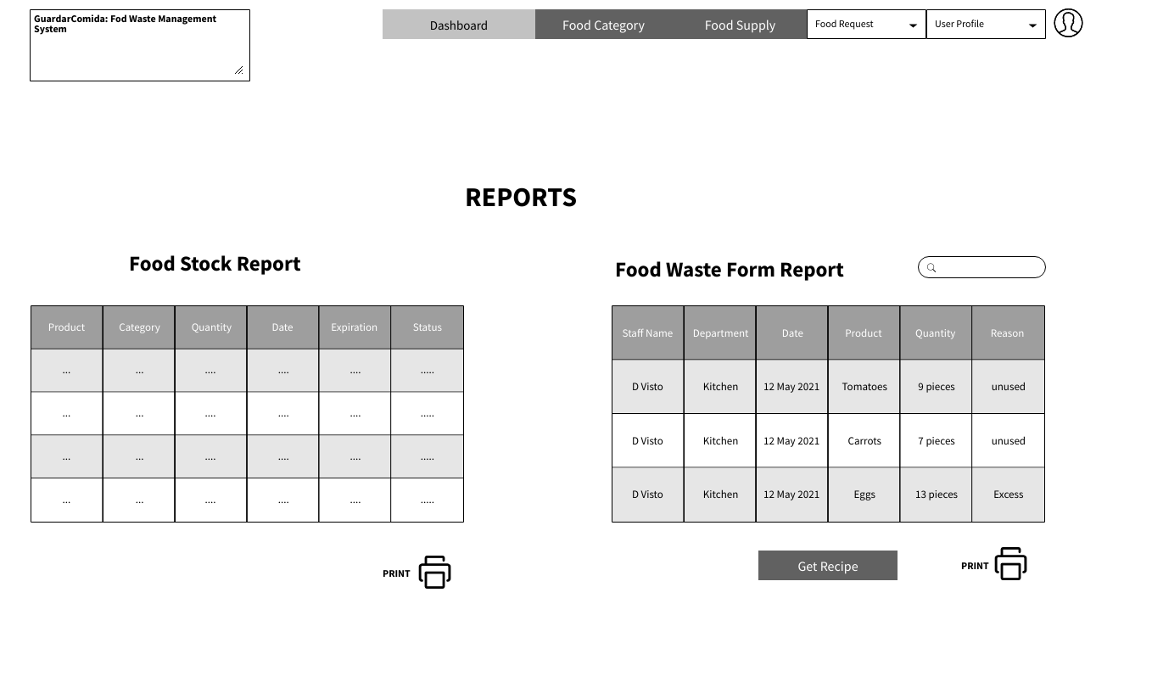
SEARCH REPORTS

Slide 28
CLICK PRINT ICON

Slide 29
CLICK USER PROFILE

Slide 30
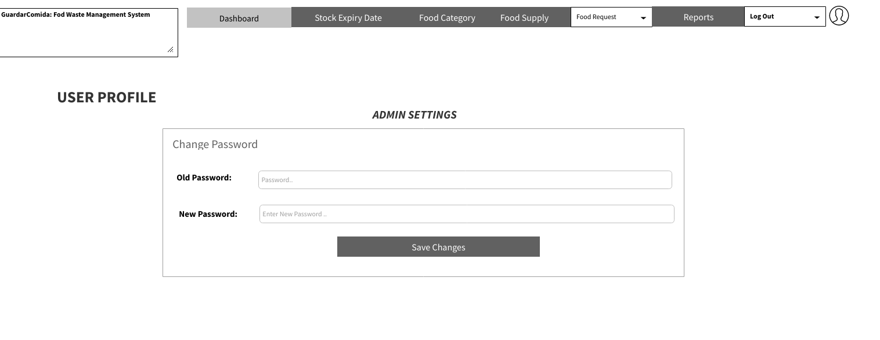
CLICK SAVE CHANGES

Slide 31
CLICK LOGOUT

Slide 32
THANK YOU!

